Slide 1

MINI PROJECT PRESENTATION
EDA & STATS
Presentation by: (Group 13)
NARASHIMMHAN R S
SINGH RAHUL SOMESHCHANDRA
LOKESH
DUDI SUBHASH
ANIKET VERMA

Slide 2

INTRODUCTION TO PROBLEM STATEMENT
Briefly introduce Company X and its objective of investing in top teams in the league.
Explain the importance of data-driven decision-making in selecting the right teams.
Provide an overview of the dataset and its attributes.

Slide 3
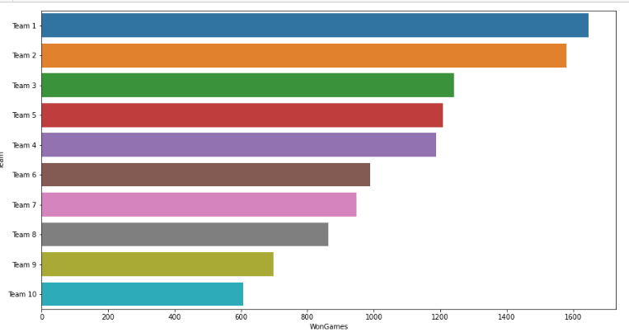
Team Performance Analysis:
Present statistics on team performance, such as the number of games played, won, drawn, and lost.
Highlight the teams with the highest number of wins and the lowest number of losses.
Show a comparison of the average number of baskets scored and conceded by different teams.

Slide 4
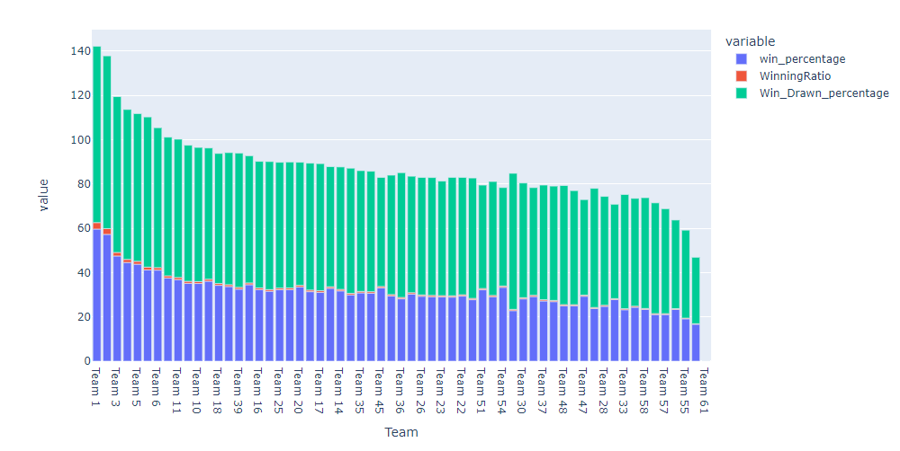
TOURNAMENT SUCCESS ANALYSIS
Discuss the number of tournaments each team has participated in.
Highlight the teams that have won the championship multiple times.
Identify the teams that have been runners-up in several tournaments.

Slide 5
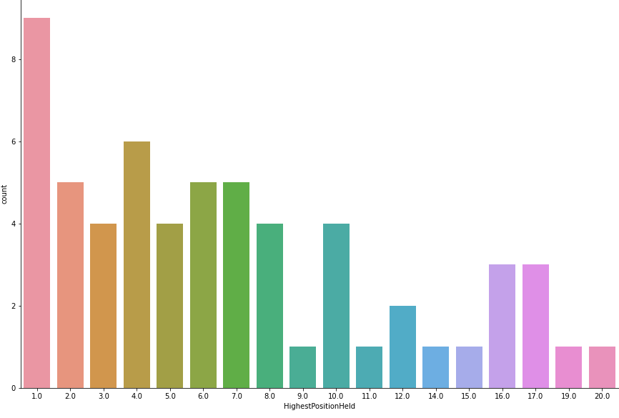

HIGHEST POSITIONS HELD BY THE TEAMS
Comparing the highest position held by each teams provide the information to invest and manage the best team in the league.

Slide 6
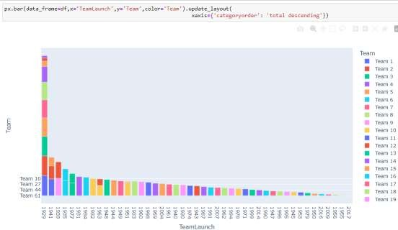
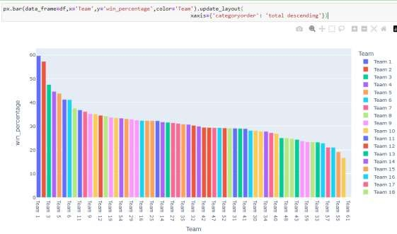
PERFORMANCE COMPARISON ANALYSIS
Comparing the performance of different basketball teams is an important part of developing effective strategies and making informed decisions.
TOURNAMENT QUALIFICATION ANALYSIS
Qualifying for tournaments is a key goal for every basketball team, and understanding the factors that contribute to successful qualification is essential for developing effective strategies.

Slide 7
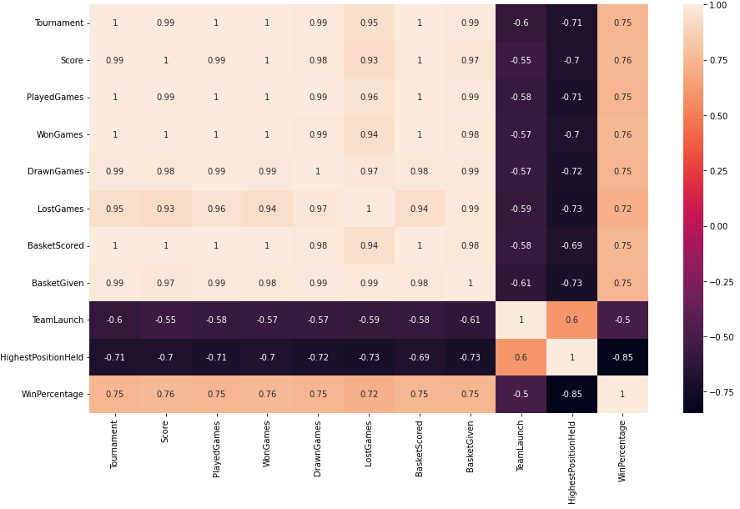

Correlation between variables:
Heat map show how the independent variables are correlated with each other.
Light colour shows strong positive correlation and dark colour shows strong negative correlation

Slide 8
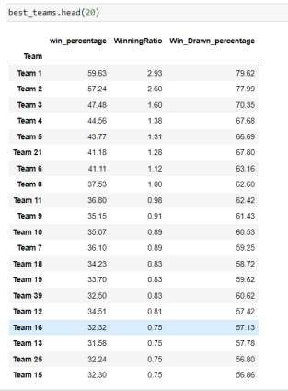
TEAM POTENTIAL AND CONTRACT OPPORTUNITIES
Summarize the key findings from the analysis.
Emphasize the importance of data analysis in making informed decisions.
Reiterate the teams recommended for investment by Company X based on their performance.

Slide 9

TAKEAWAYS & CONCLUSIONS
Team performance: The data set provides information about how teams are performing. By analyzing win-loss records, scoring differentials, and defensive statistics, teams can identify areas of improvement and make strategic decisions about game planning and player selection.
Trends over time: The basketball tournaments may last for multiple seasons or even decades, that allows analysts to identify trends in player or team performance. This information can be used to predict future outcomes, evaluate coaching strategies, and make strategic decisions about team development.
Importance of certain statistics: By analyzing correlations and distributions in the data, analysts can identify which statistics are more important for predicting.
conclusion : By incorporating statistical analysis and EDA techniques, analysts get a deeper understanding of basketball data and use it to make data-driven decisions. This method can be useful for coaches, teams, and analysts who want to optimize player and team performance, identify areas for improvement, and make strategic decisions based on data.

Slide 10
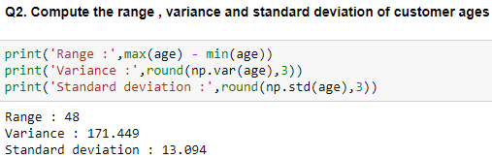
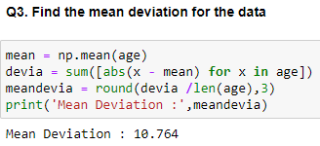
STATISTICS
Data:
age = [42, 44, 62, 35, 20, 30, 56, 20, 23, 41, 55, 22, 31, 27, 66, 21, 18, 24, 42, 25, 32, 50, 31, 26, 36, 39, 40, 18, 36, 22]

Slide 11
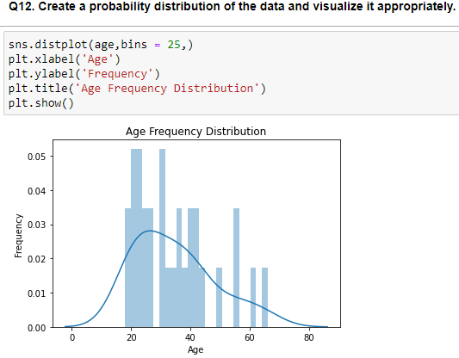
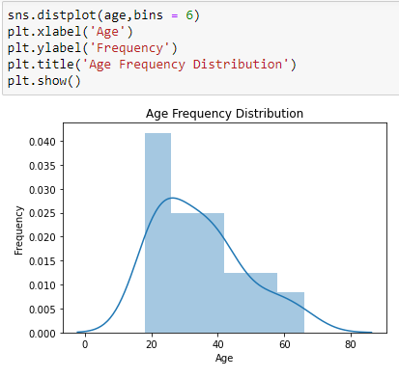
FREQUENCY DISTRIBUTION AND PROBABILITY DISTRIBUTION OF DATA

Slide 12
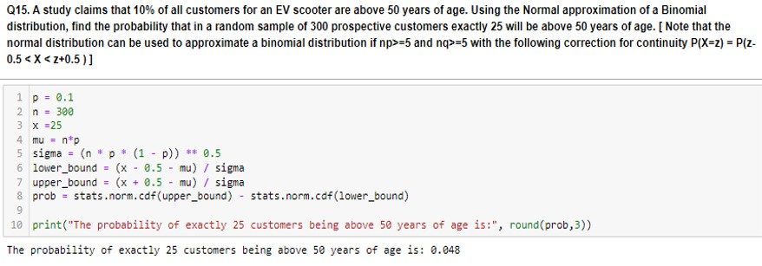
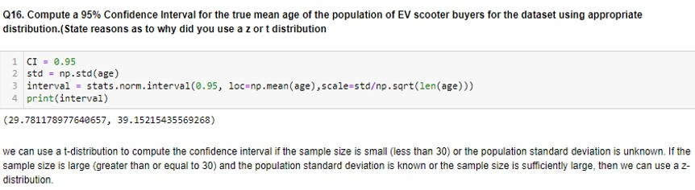

Slide 13
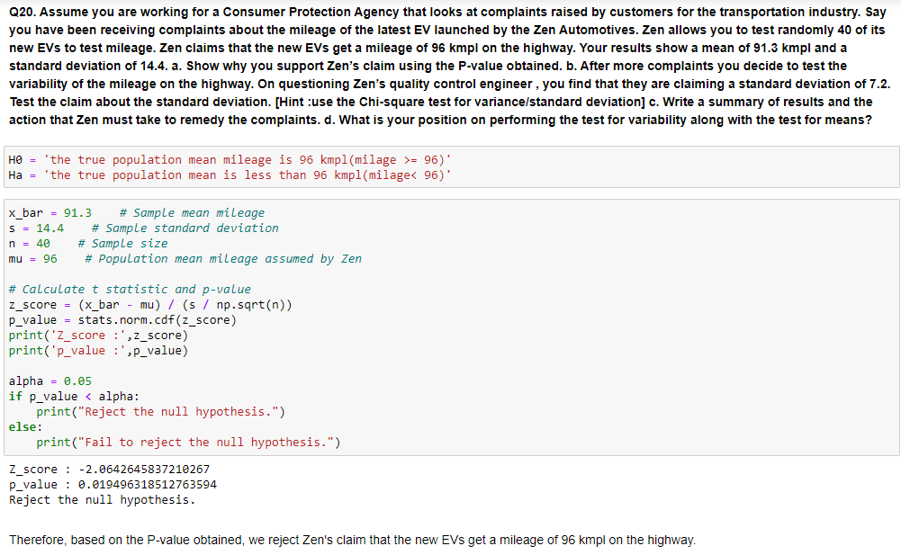
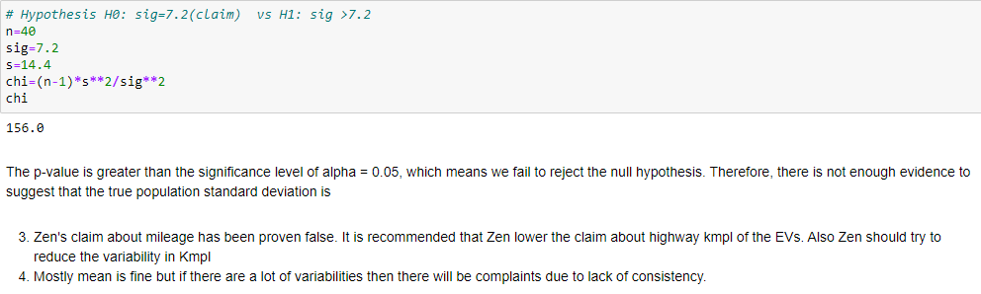

Slide 14
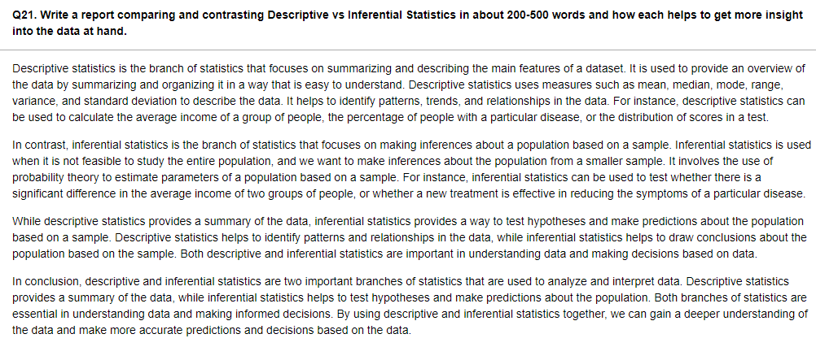

Slide 15

THANK YOU!

